Slide 1
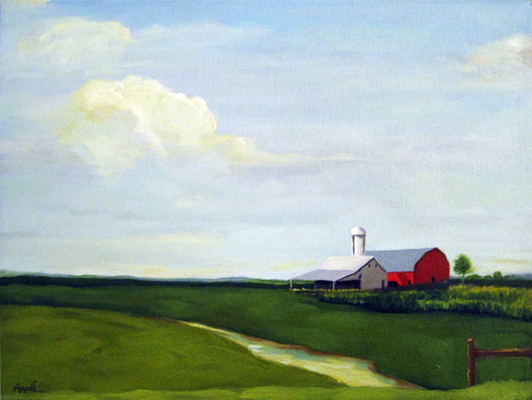
Machine Learning in Agriculture
A look
into
the future
of Agriculture
By Zane Page

Slide 2
Machine Learning in Agriculture
Topic Selection: I picked my topic because of I was curious about ML and applications that it has in real life

Slide 3
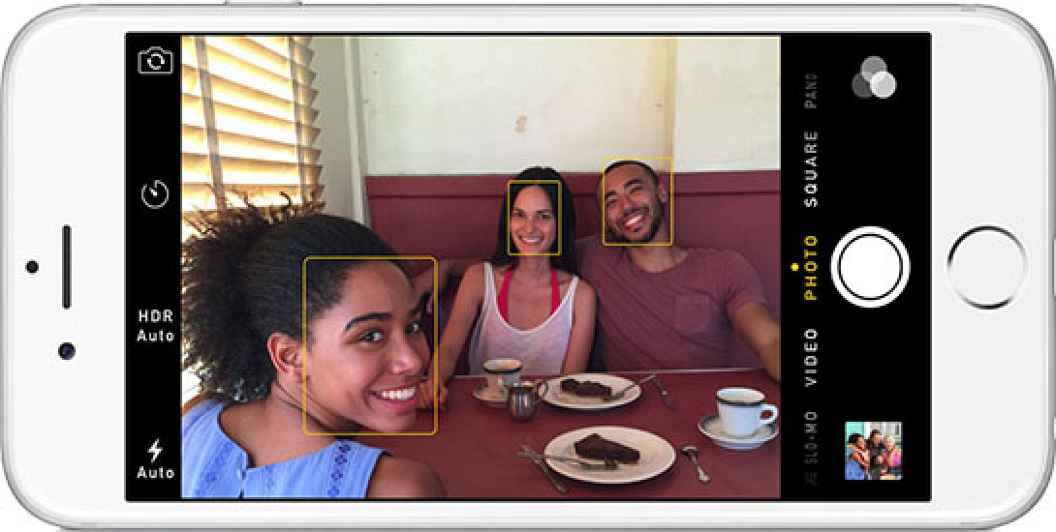
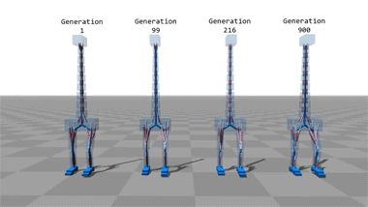


Machine Learning
Machine Learning is a way of getting computers to learn new behavior based on empirical data to complete tasks that cannot be programmed traditionally.

Slide 4


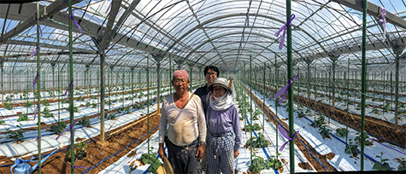
Not only for big companies…

Slide 5
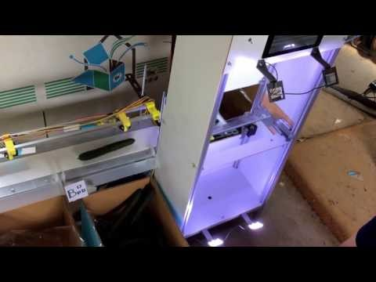

Slide 6
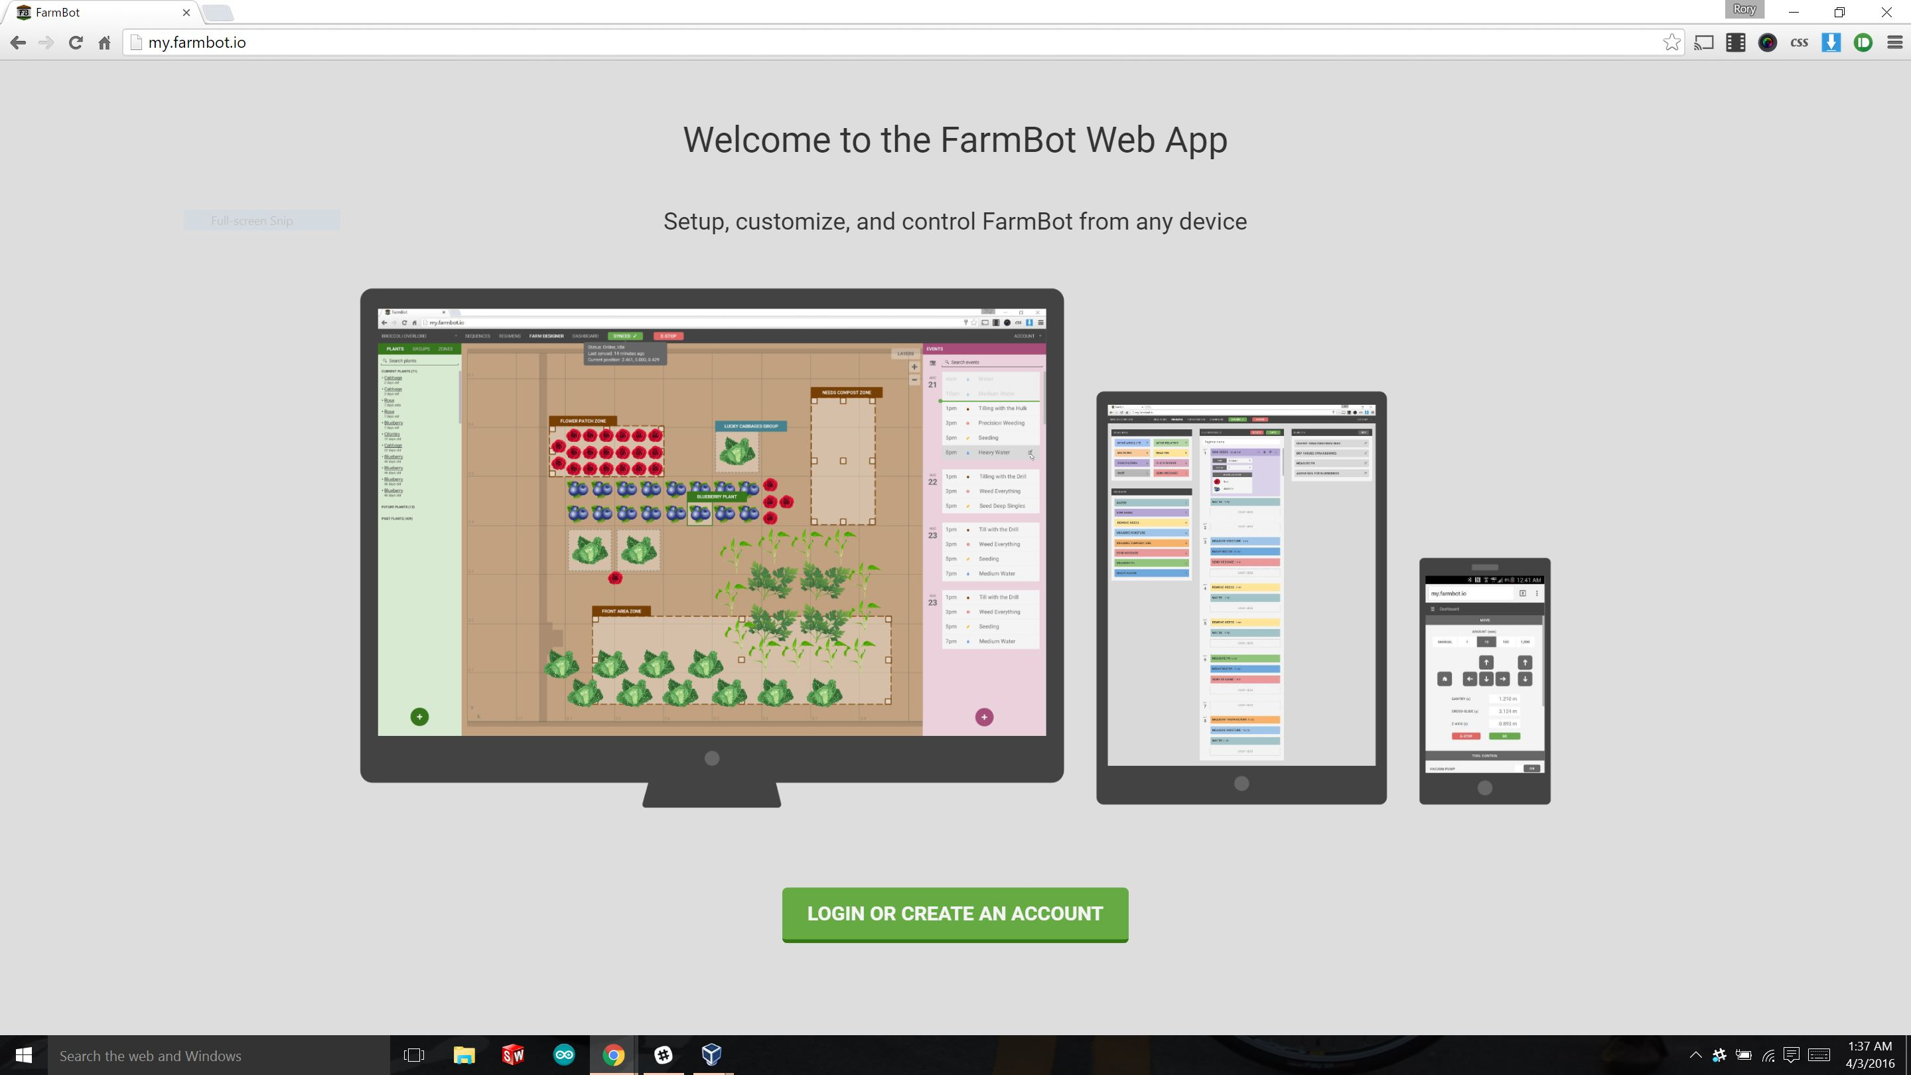
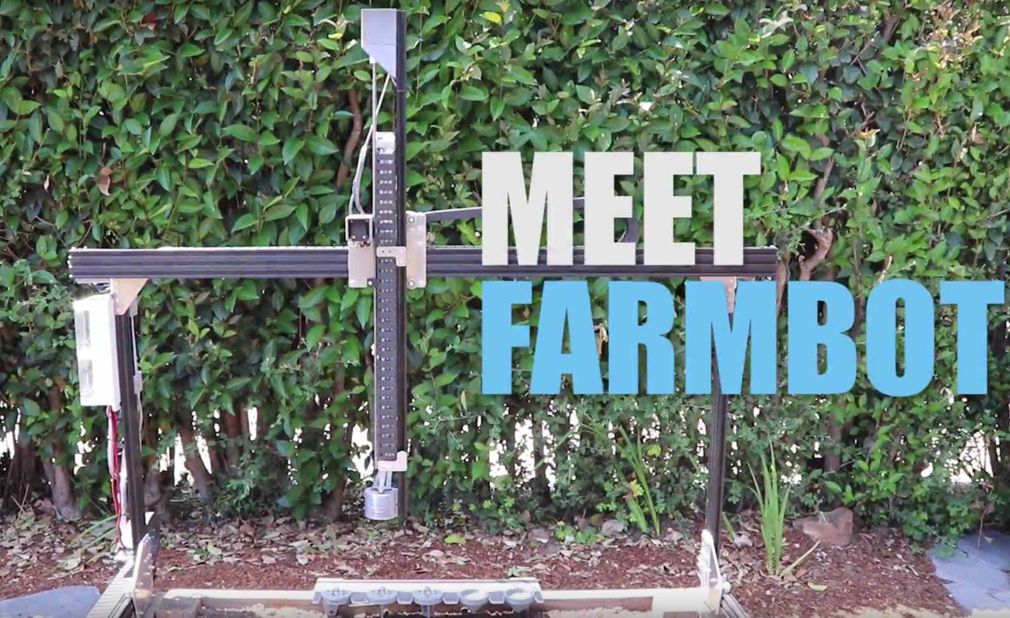
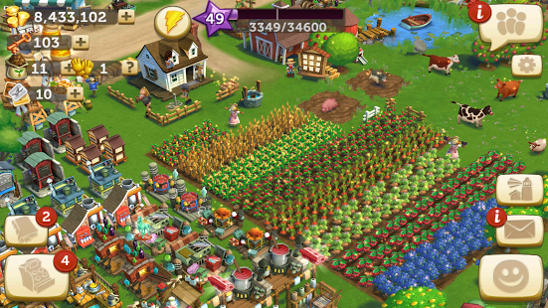
Research Applications

Slide 7
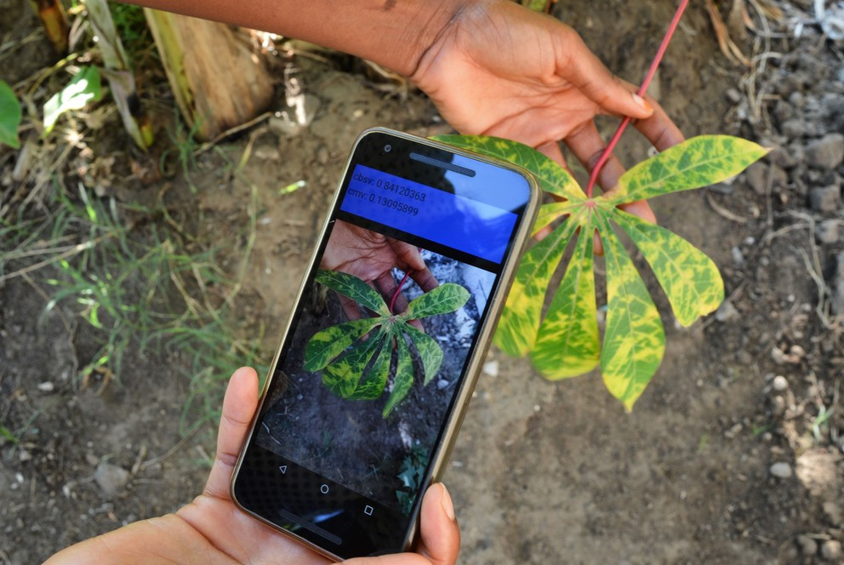
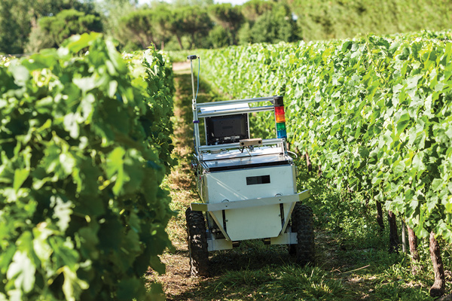
More Research Applications

Slide 8
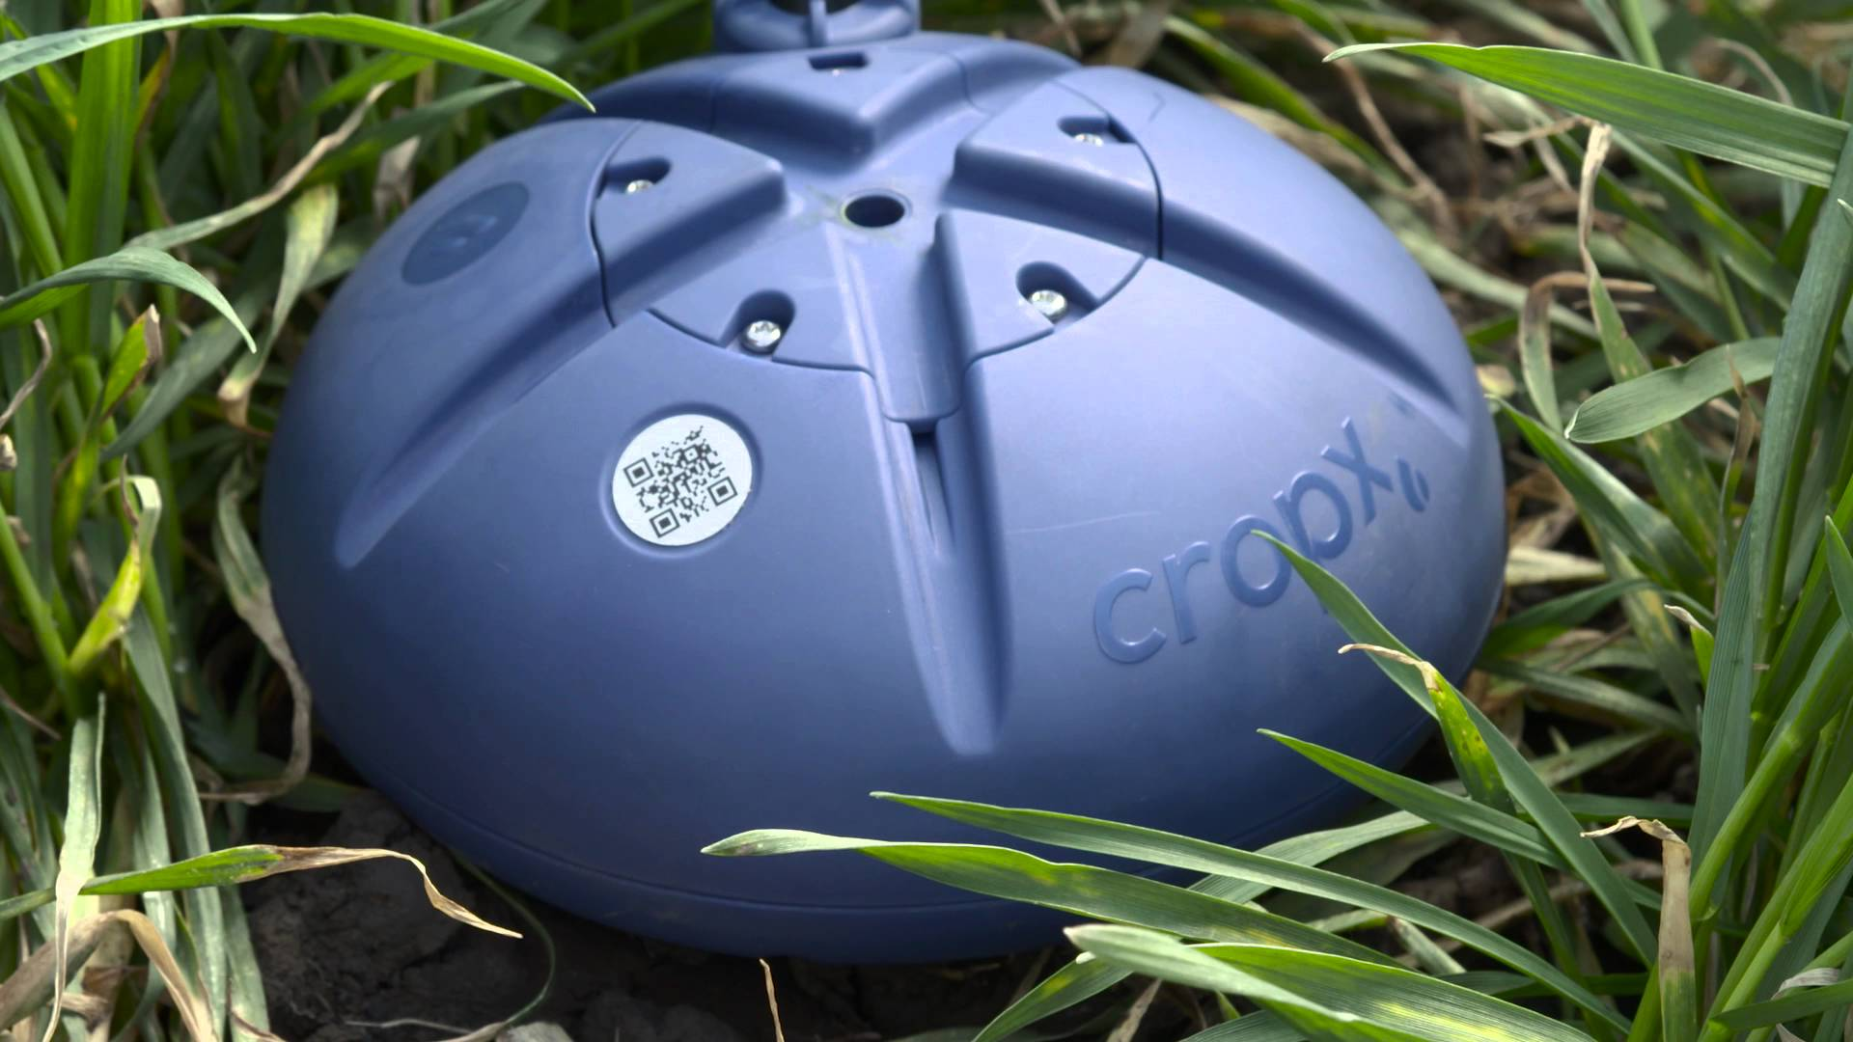
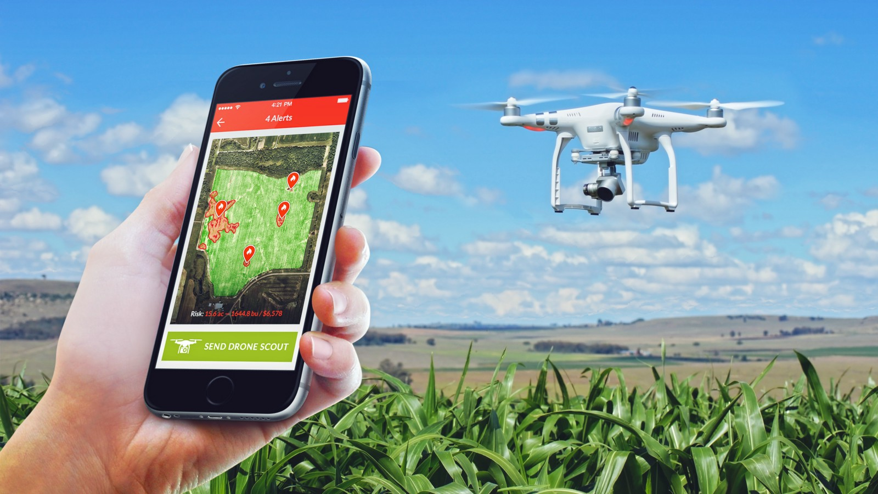
Private Ag-Tech Firms

Slide 9
Abandoned Farmhouse
BY TED KOOSER
He was a big man, says the size of his shoes
on a pile of broken dishes by the house;
a tall man too, says the length of the bed
in an upstairs room; and a good, God-fearing man,
says the Bible with a broken back
on the floor below the window, dusty with sun;
but not a man for farming, say the fields
cluttered with boulders and the leaky barn.
A woman lived with him, says the bedroom wall
papered with lilacs and the kitchen shelves
covered with oilcloth, and they had a child,
says the sandbox made from a tractor tire.
Money was scarce, say the jars of plum preserves
and canned tomatoes sealed in the cellar hole.
And the winters cold, say the rags in the window frames.
It was lonely here, says the narrow country road.
Something went wrong, says the empty house
in the weed-choked yard. Stones in the fields
say he was not a farmer; the still-sealed jars
in the cellar say she left in a nervous haste.
And the child? Its toys are strewn in the yard
like branches after a storm—a rubber cow,
a rusty tractor with a broken plow,
a doll in overalls. Something went wrong, they say.

Slide 10
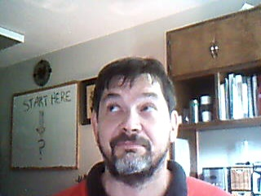


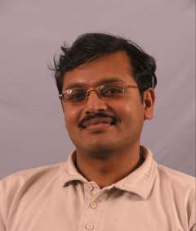
Interview
Dr. Glen Rains – Ag Engineer
Rory Orson- Founder of Farmbot
Chuck Gill – Journalist at Penn State
Sudhagar Mani – Ag Engineer
And others…

Slide 11
Sources
Sorvino, Chloe. “The 25 Most Innovative Ag-Tech Startups.” Forbes, Forbes Magazine, 5 July 2017, www.forbes.com/sites/maggiemcgrath/2017/06/28/the-25-most-innovative-ag-tech-startups/#4531d85a4883.https://agfunder.com/
Hosch, William L. “Machine Learning.” Encyclopædia Britannica, Encyclopædia Britannica, Inc., 11 Aug. 2009, www.britannica.com/technology/machine-learning.
Gill, Chuck. “Artificial Intelligence Could Help Farmers Diagnose Crop Diseases.” Penn State University, news.psu.edu/story/429727/2016/10/04/research/artificial-intelligence-could-help-farmers-diagnose-crop-diseases.
http://delivery.acm.org.proxy-remote.galib.uga.edu/10.1145/2430000/2425849/p55-corbett-davies.pdf?ip=128.192.114.19&id=2425849&acc=ACTIVE%20SERVICE&key=AA86BE8B6928DDC7%2EB68F0B462DD42179%2E4D4702B0C3E38B35%2E4D4702B0C3E38B35&CFID=995377388&CFTOKEN=79667202&__acm__=1508100789_aaf786a7693f40acad04b373aad7711b
http://delivery.acm.org.proxy-remote.galib.uga.edu/10.1145/3040000/3036297/p1-Joshi.pdf?ip=128.192.114.19&id=3036297&acc=ACTIVE%20SERVICE&key=AA86BE8B6928DDC7%2EB68F0B462DD42179%2E4D4702B0C3E38B35%2E4D4702B0C3E38B35&CFID=995377388&CFTOKEN=79667202&__acm__=1508098988_a9f80818b021c0ba5ca71f21b7cd3c86
Sato, Kaz. “How a Japanese Cucumber Farmer Is Using Deep Learning and TensorFlow | Google Cloud Big Data and Machine Learning Blog | Google Cloud Platform.” Google, Google, cloud.google.com/blog/big-data/2016/08/how-a-japanese-cucumber-farmer-is-using-deep-learning-and-tensorflow.
“TensorFlow.” TensorFlow, www.tensorflow.org/.Tantawi, Randa, PhD. “Machine Learning.” Salem Press
Encyclopedia, January. EBSCOhost, proxyremote.galib.uga.edu/login?url=http://search.ebscohost.com/login.aspx?direct=true&db=ers&AN=90558380&site=eds-live

